Slide 1
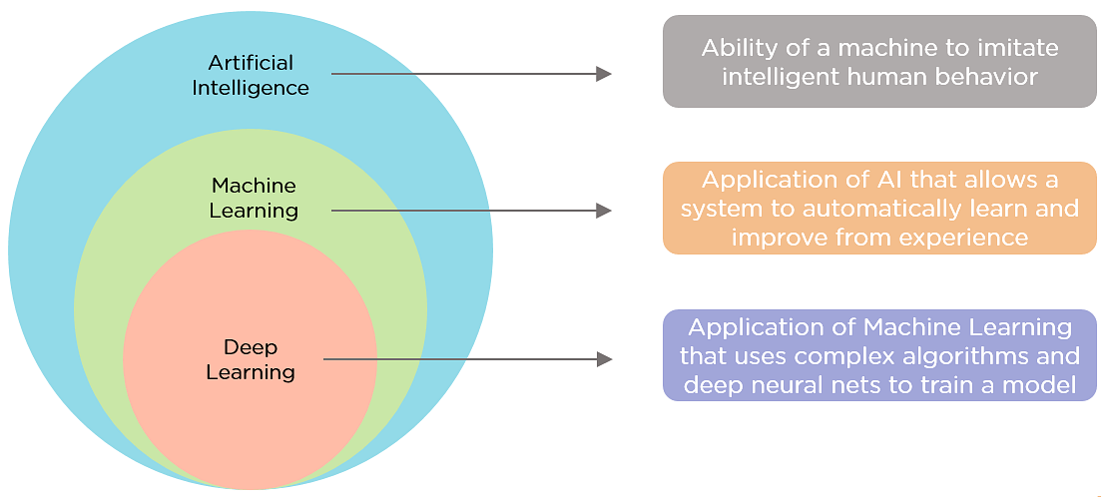
(Source: https://www.simplilearn.com/ice9/free_resources_article_thumb/AIvsML.png)
Notes:
Machine learning, a sub-class of artificial intelligence as shown in Fig, is self-learning based on algorithms that mean the system learns from its experience.
Deep Learning is a subcategory of machine learning. It is a network model with neurons having a lot of parameters and layers in between input and output. DL follows the neural network architectures approach. Thus, called deep neural networks.
Artificial Intelligence vs. Machine Learning vs. Deep Learning | Built In
https://builtin.com/artificial-intelligence/ai-vs-machine-learning

Slide 2
Applications
Machine Learning
Predictive programs
Email spam identifiers
Principal Components Analysis
Photo OCR
Anomaly Detection
…
Deep Learning
Computer vision
facial recognition…
Self-driving cars
Art Generation
Natural Language Processing
Neural machine translation…
…
Neha Sharma et al., 2021, Machine Learning and Deep Learning Applications-A Vision.
Notes:
Machine learning and deep learning systems are used for different applications. Where they are used: Basic machine learning applications include predictive programs (such as forecasting prices in the stock market or where and when the next hurricane will hit), email spam identifiers, and programs that design evidence-based treatment plans for medical patients. For deep learning, one highly publicized application is self-driving cars—the programs use many layers of neural networks to determine objects to avoid, recognize traffic lights, and know when to speed up or slow down.

Slide 3
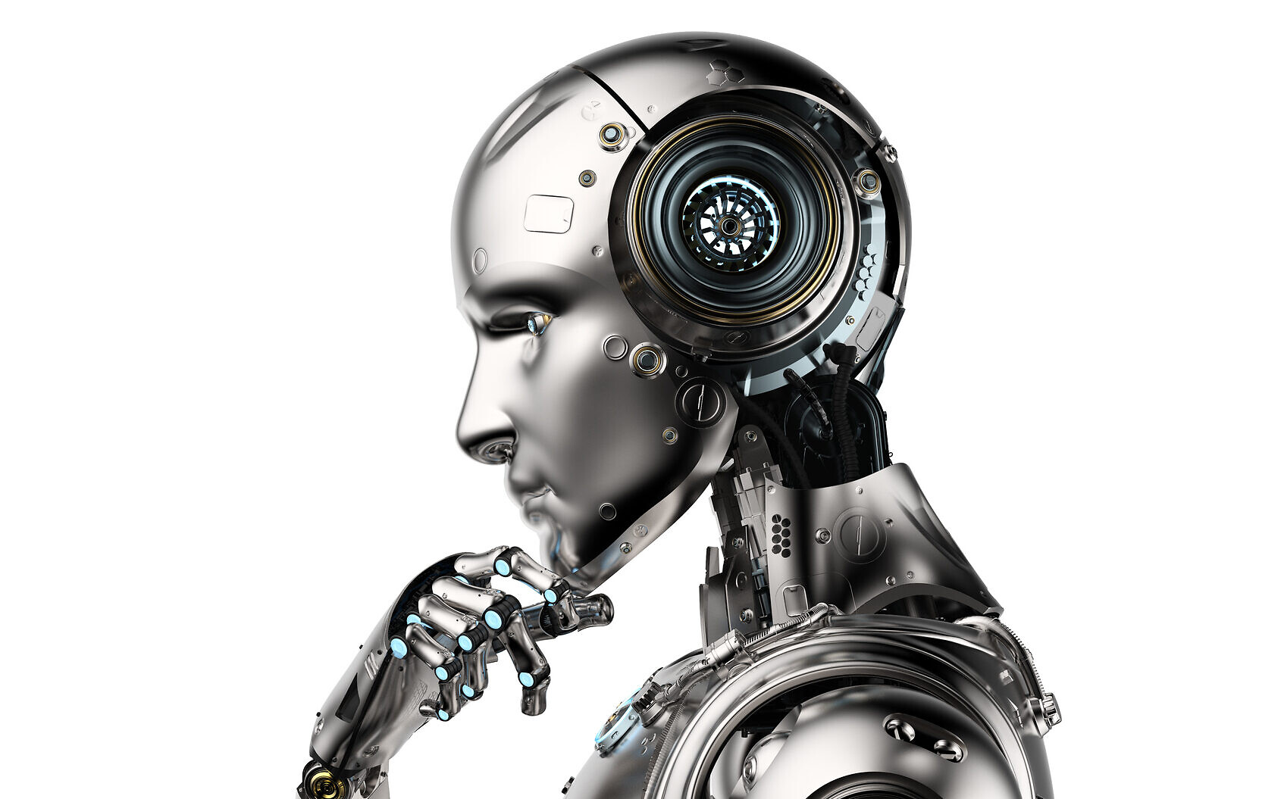
Applications of AI
Art
Entertainment
Healthcare
Automobile
Travel and Transport
Agriculture
Robotics
Biology
Space Exploration
E-commerce
Finance
Social Media
Education
Gaming
Surveillance
Illustrative image of a robot, Artificial Intelligence (AI); (PhonlamaiPhoto; iStock by Getty Images)
Notes:
https://www.ai-startups.org/
https://www.interviewbit.com/blog/applications-of-artificial-intelligence/
https://www.javatpoint.com/application-of-ai
https://builtin.com/artificial-intelligence/examples-ai-in-industry
https://techvidvan.com/tutorials/artificial-intelligence-applications/
AI For Cyber Security: 27 Companies You Should Know | Built In

Slide 4




AI in Art
OpenAI
Midjourney
StyleGAN
Art generative tools

Slide 5
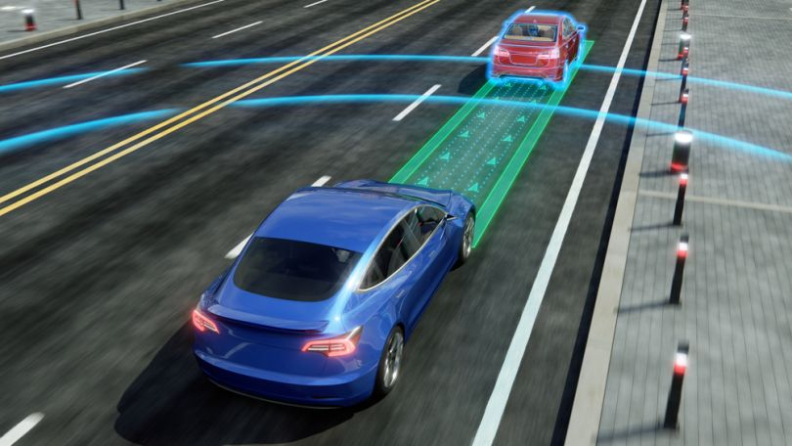
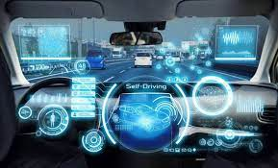
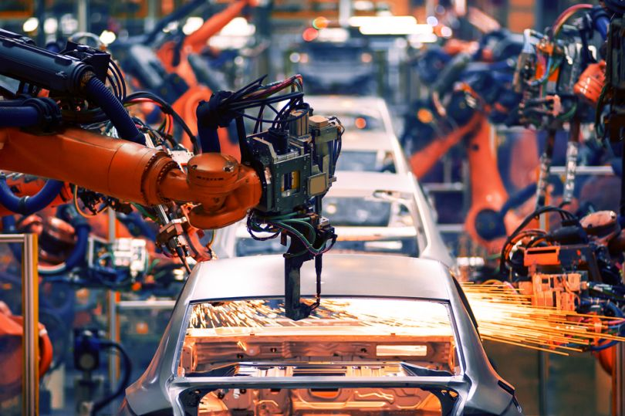
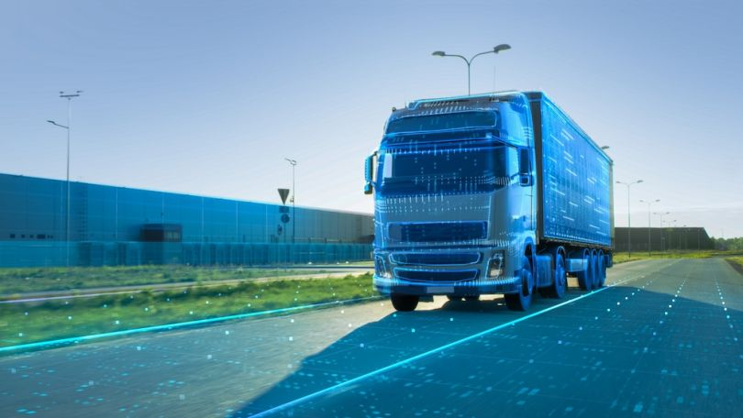
AI in Automobile
Autonomous Vehicles
Driver Assistance
Auto Manufacturing
Autonomous Delivery
Automotive companies
Notes:
Image source: https://readwrite.com/how-self-driving-cars-can-shape-our-future/
10 AI in Manufacturing Examples to Know | Built In
Artificial Intelligence In Cars: 13 Types of Automotive AI | Built In

Slide 6
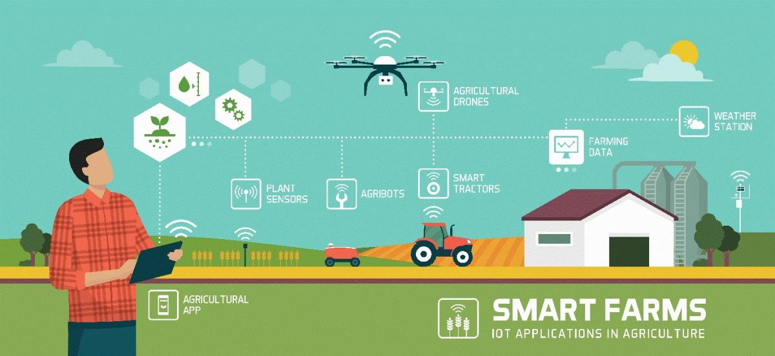
AI in Agriculture
Agriculture Robots
Autonomous robots for harvesting, Automatic weeding BoniRob, etc
Aerial survey and imaging
AI can analyze imagery from drones and satellites to help farmers monitor crops and herds
Intelligent spraying
UAVs equipped with AI sensors can detect weed or crop and automate spraying of herbicides, pesticides or fertilizer uniformly across a field
Crop and soil monitoring
Monitor the crop health, soil defects, nutrient deficiencies in soil, etc
Disease Diagnosis
Insect and plant disease detection, finding bugs with code
Livestock monitoring
Track the livestock health, activity, nutrition level, and growth
Produce grading and sorting
Use computer vision automate the sorting and grading process with higher accuracy rates and speed
Predictive insights
Insights on the right time to sow the seeds, the output yield of crops, and prices for maximum productivity and profit
Notes:
AI in Agriculture: 8 Practical Applications [2022 Update] (v7labs.com)
Towards Future Farming: How Artificial Intelligence is transforming the Agriculture Industry – Wipro
Home | OneCup AI
https://www.ai-startups.org/top/agriculture/
Top Agriculture Companies 2022 | Built In(https://builtin.com/companies/type/agriculture-companies)
Image source: https://businesswales.gov.wales/farmingconnect/sites/farmingconnect/files/styles/wysiwyg_lg/public/TA%20climate%2029.04.20.jpg?itok=22H6SMrx

Slide 7

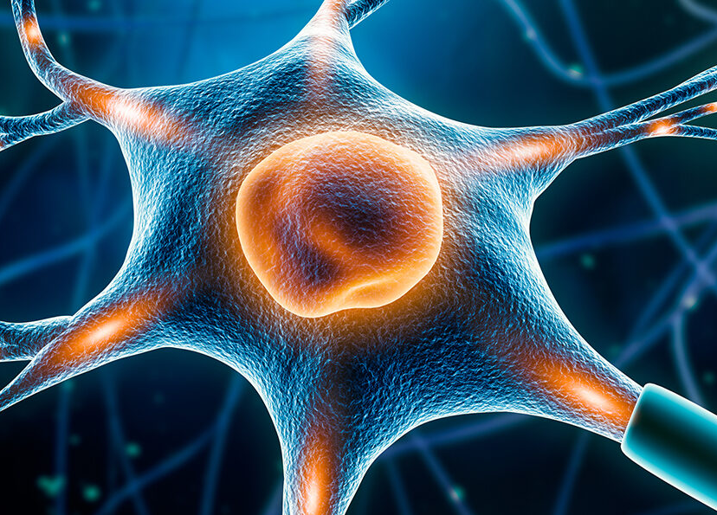
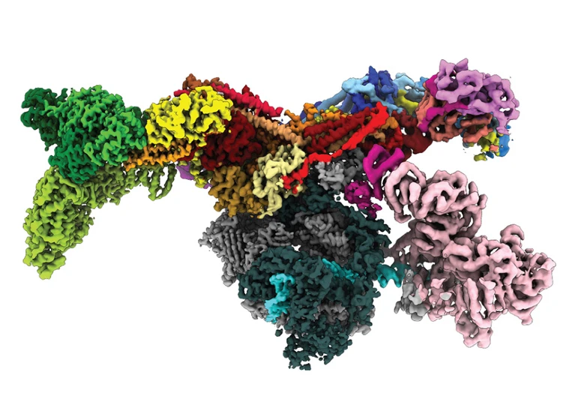

AI in Biology
Image analysis: disease diagnosis
Neuroscience
Protein structure prediction
Drug discovery
Notes:
Artificial Intelligence for Biology
https://pubmed.ncbi.nlm.nih.gov/34448841/
https://www.nature.com/articles/d41586-021-02037-0
https://bitesizebio.com/64186/artificial-intelligence-in-biology/
https://www.pfizer.com/news/behind-the-science/when-ai-meets-biology
https://aibiology.github.io/
Image source:
https://news.mit.edu/2020/how-well-computers-symptoms-diseases-0108
https://www.nature.com/articles/d41586-021-02037-0
https://www.ppd.com/therapeutic-expertise/neuroscience/
https://www.outsourcing-pharma.com/Article/2020/07/20/Platform-designed-to-accelerate-drug-discovery-development

Slide 8
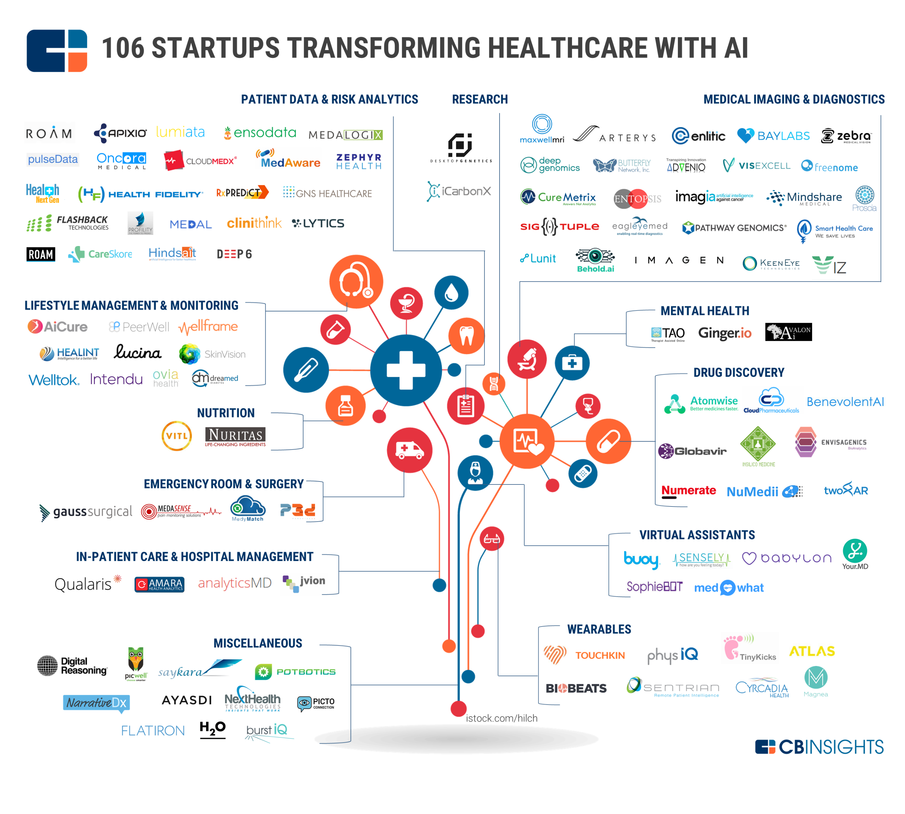
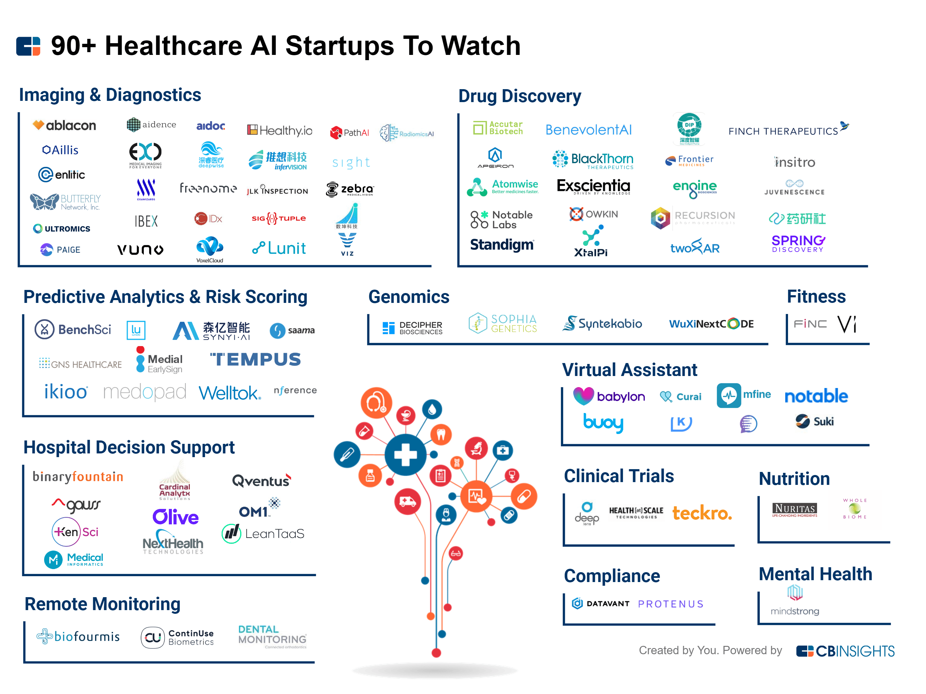
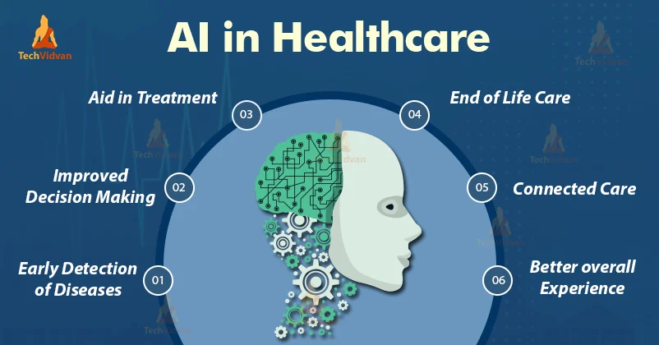
AI in Healthcare
Notes:
https://research.aimultiple.com/healthcare-ai-use-cases/
https://marutitech.com/artificial-intelligence-in-healthcare/
https://mobisoftinfotech.com/resources/blog/top-15-ai-applications-in-healthcare/
https://www.cbinsights.com/research/healthcare-lifesciences/
https://www.healthcatalyst.com/insights/introducing-healthcare-ai-health-catalyst
https://builtin.com/artificial-intelligence/artificial-intelligence-healthcare
Course: Artificial Intelligence in Healthcare | Program | Stanford Online
40 AI in Healthcare Examples Transforming Medicine | Built In
Image source: https://techvidvan.com/tutorials/top-8-applications-of-artificial-intelligence-in-healthcare/
AI Startups: https://www.cbinsights.com/research/artificial-intelligence-startups-healthcare/
Article: Artificial Intelligence for Hospital Health Care: Application Cases and Answers to Challenges in European Hospitals

Slide 9
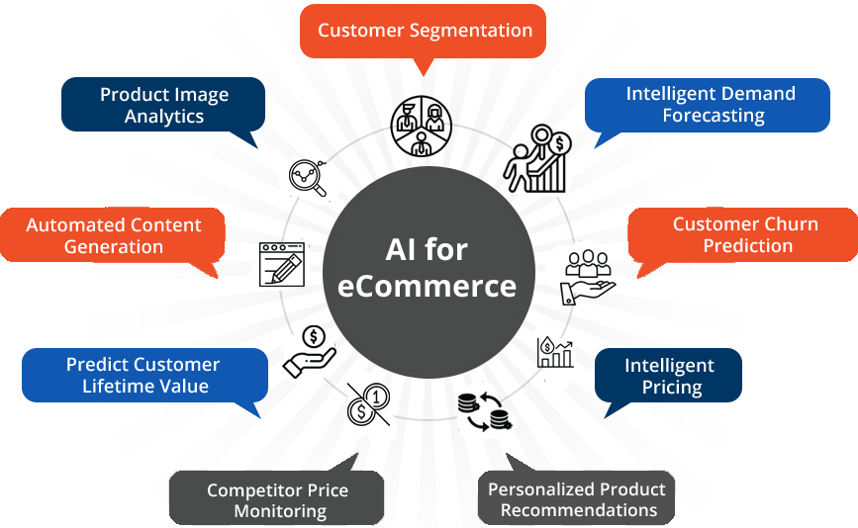
AI in E-commerce
Notes:
https://indatalabs.com/industry/ai-solutions-ecommerce?gclid=CjwKCAjws--ZBhAXEiwAv-RNLzlPgMxdIbtFYx87Jeh8kFz8Fe8iXIhZ49mqxeDLYfJ26-2W4TUDCxoCG1cQAvD_BwE
https://www.bigcommerce.com/articles/ecommerce/ecommerce-ai/
https://medium.com/@Countants/how-artificial-intelligence-is-transforming-the-e-commerce-industry-countants-scalable-custom-73ae06836d35
https://masterofcode.com/blog/state-of-artificial-intelligence-ai-in-ecommerce-statistics-and-deployment
Top eCommerce Companies 2022 | Built In (https://builtin.com/companies/type/ecommerce-companies)
17 Examples Of AI In Retail & E-Commerce to Know | Built In (https://builtin.com/artificial-intelligence/ai-retail-ecommerce-tech)
Image source: https://www.aismartz.com/ai-for-ecommerce.html
======
https://usmsystems.com/use-cases-of-ai-in-ecommerce/
#1 AI Creates Customer-Centric Search, #6 Provides Personal Touch With AI Chatbot
#2 Retarget Potential Customers, #7 Empower store Employees
#3 Creates Efficient Sales Process, #8 Identifies Exceptional Target Opportunities
#4 Advanced Virtual Assistants, #9 Enlist Fake Reviews
#5 Creates Personalization Across Multiple Devices, #10 Bridges Gap between Privacy and Personalization

Slide 10
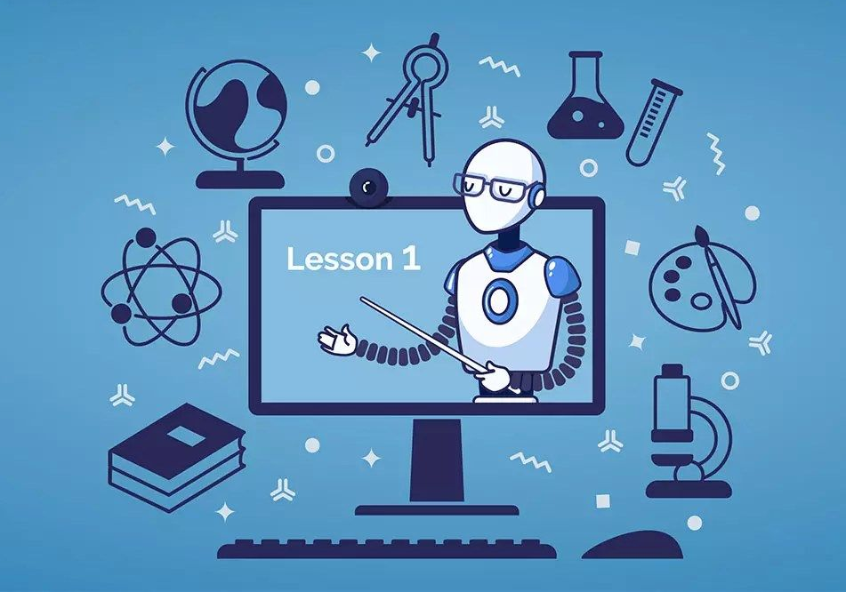
AI in Education
Assessing and Addressing Students’ Skills and Weaknesses
Empowering Students with Crowdsourced Learning
Creating Customized Learning Materials
Decreasing Time Spent Grading
Notes:
https://onlinedegrees.sandiego.edu/artificial-intelligence-education/
https://www.iste.org/areas-of-focus/AI-in-education
https://www.teachthought.com/the-future-of-learning/roles-for-artificial-intelligence-in-education/
https://www.dell.com/en-us/perspectives/4-ways-artificial-intelligence-is-revolutionizing-education/?gacd=9643275-1040-5761040-266682520-0&dgc=st&gclid=CjwKCAjws--ZBhAXEiwAv-RNLzZEDNpueCcSAfjWOm3utvpcfEQT7fhORJyyRm79sRDgxphl43BvFBoCjfsQAvD_BwE&gclsrc=aw.ds&nclid=hLT9xbhRawlVEufwhtengbCMGl7DRYmnOb2FG_YuVoHvj4XhRYuq7hshL2Q0ZjQQ
AI In Education: 15 Examples to Know | Built In (https://builtin.com/artificial-intelligence/ai-in-education)
13 Great AI Books For 2022 | Built In
Image source: https://www.thedigitalspeaker.com/school-tomorrow-ai-education-changes-how-we-learn/

Slide 11
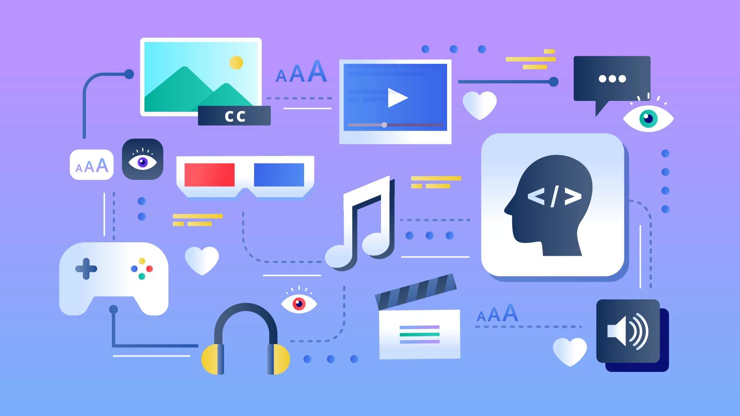
AI in Entertainment
Enhanced User Experience & Personalization
Marketing and Advertising
Search Optimization
Extensive Usages of VR and AR Technologies
Streaming Quality
Auto-Generation and Post-Production
Real-Time Object Detection During Entertainment Events
Controlling the Online Content Broadcasting
Detecting & Controlling the Fake Content
Media
Film & TV
Gambling
Sport
Videogame
Notes:
https://www.analyticssteps.com/blogs/6-applications-ai-entertainment-industry
https://usmsystems.com/ai-in-entertainment-industry-top-4-applications-use-cases/
https://medium.com/technology-hits/the-future-of-entertainment-with-artificial-intelligence-75483644e189
https://www.aitimejournal.com/how-ai-is-changing-the-entertainment-industry
https://datamites.com/blog/artificial-intelligence-in-media-and-entertainment-industries/
https://www.forbes.com/sites/aparnadhinakaran/2022/07/07/ai-at-the-forefront-of-media-and-entertainment/?sh=52905fa73e5f
Image source: https://www.rev.com/blog/speech-to-text-technology/ai-and-speech-recognition-trends-media-and-entertainment

Slide 12
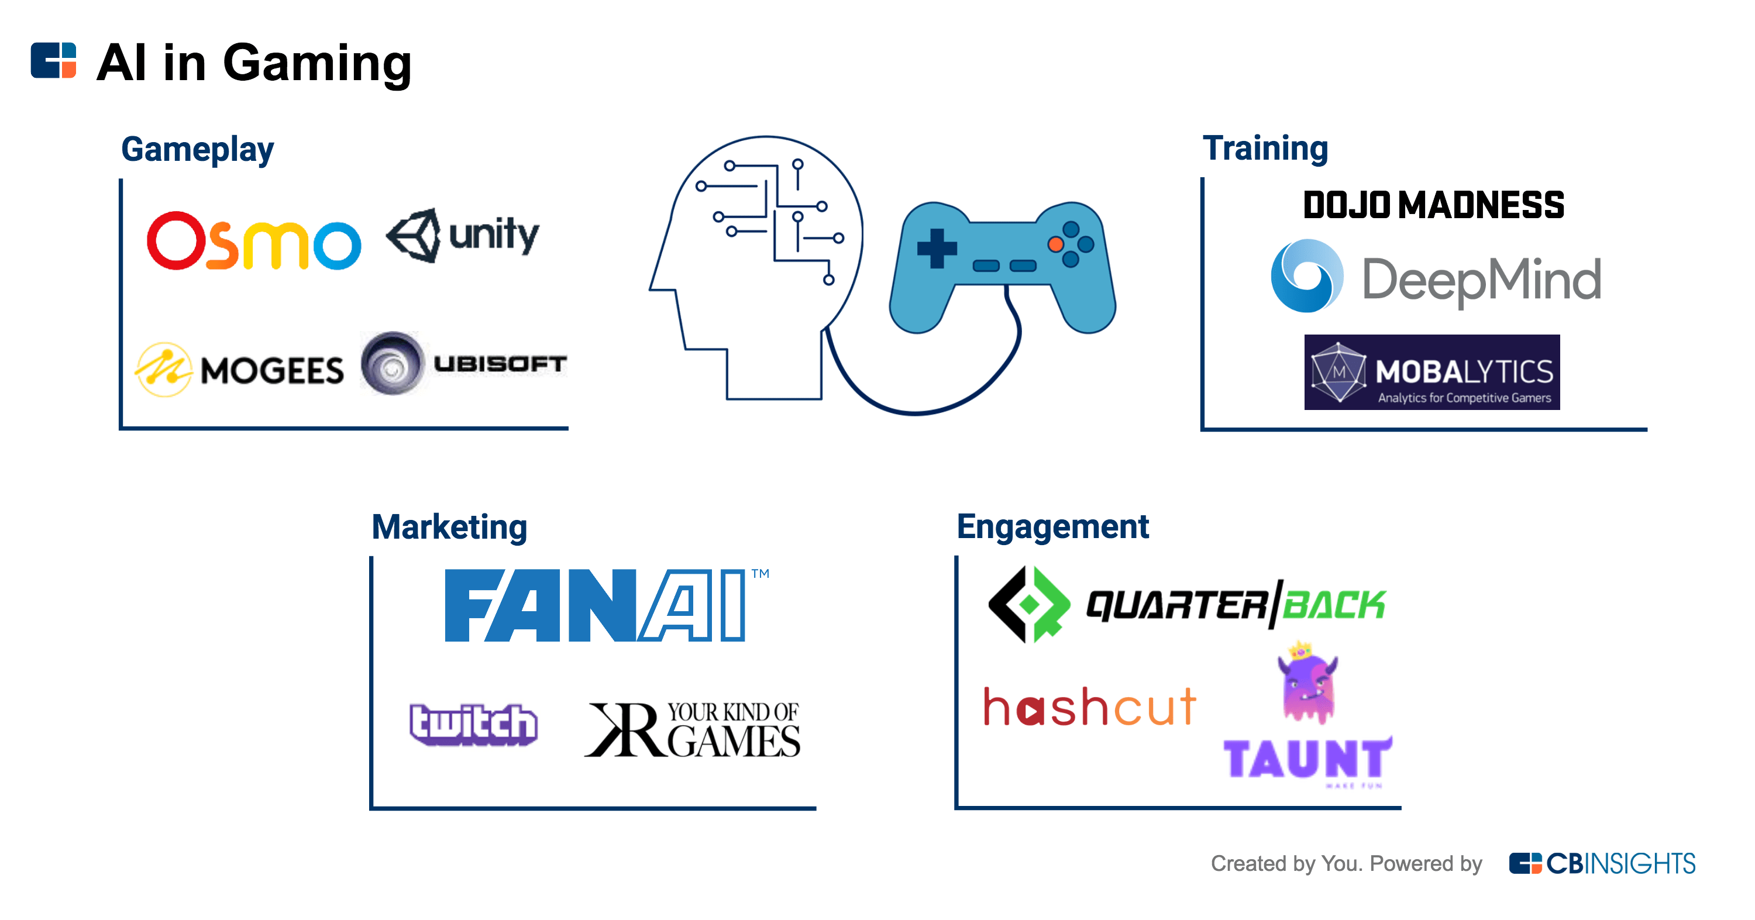

AI in Gaming
1
5
Smart NPCs
Procedural Content Generation
2
Pathfinding
6
Data Mining
3
Decision Making
7
Playing Test Games
4
8
Cheating and Detecting Cheats
Player Experience Modeling
Notes:
https://www.engati.com/blog/ai-in-gaming
https://www.forbes.com/sites/forbestechcouncil/2022/07/13/how-artificial-intelligence-can-empower-the-future-of-the-gaming-industry/?sh=1a925e464a9f
https://www.gamedesigning.org/gaming/ai-in-gaming/
https://aithority.com/computer-games/understanding-the-role-of-ai-in-gaming/
Course: Artificial Intelligence for Simple Games | Udemy
AI Games: 10 Leading Companies To Know | Built In
Image source: https://theconversation.com/an-ai-taught-itself-to-play-a-video-game-for-the-first-time-its-beating-humans-118028
https://www.cbinsights.com/research/ai-gaming-expert-intelligence/

Slide 13
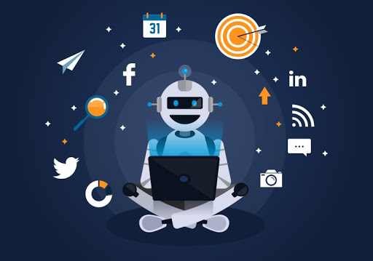
AI in Social Media
Create social media posts and optimize social media campaigns
Figure out what posts work best using advanced analytics
Inform social media strategy.
Measure brand and trends across each social media channel and find your target audience
Write social ads
Decrease social media management time and costs across platforms
Conduct social media monitoring
Notes:
https://www.marketingaiinstitute.com/blog/ai-for-social-media
https://www.marketingaiinstitute.com/blog/what-is-artificial-intelligence-for-social-media
https://aimagazine.com/ai-strategy/how-are-social-media-platforms-using-ai
https://statusbrew.com/insights/social-media-ai/
https://www.unite.ai/10-best-ai-tools-for-social-media/
Image source: https://www.seoresellersaustralia.com.au/what-is-ai-for-social-media/

Slide 14
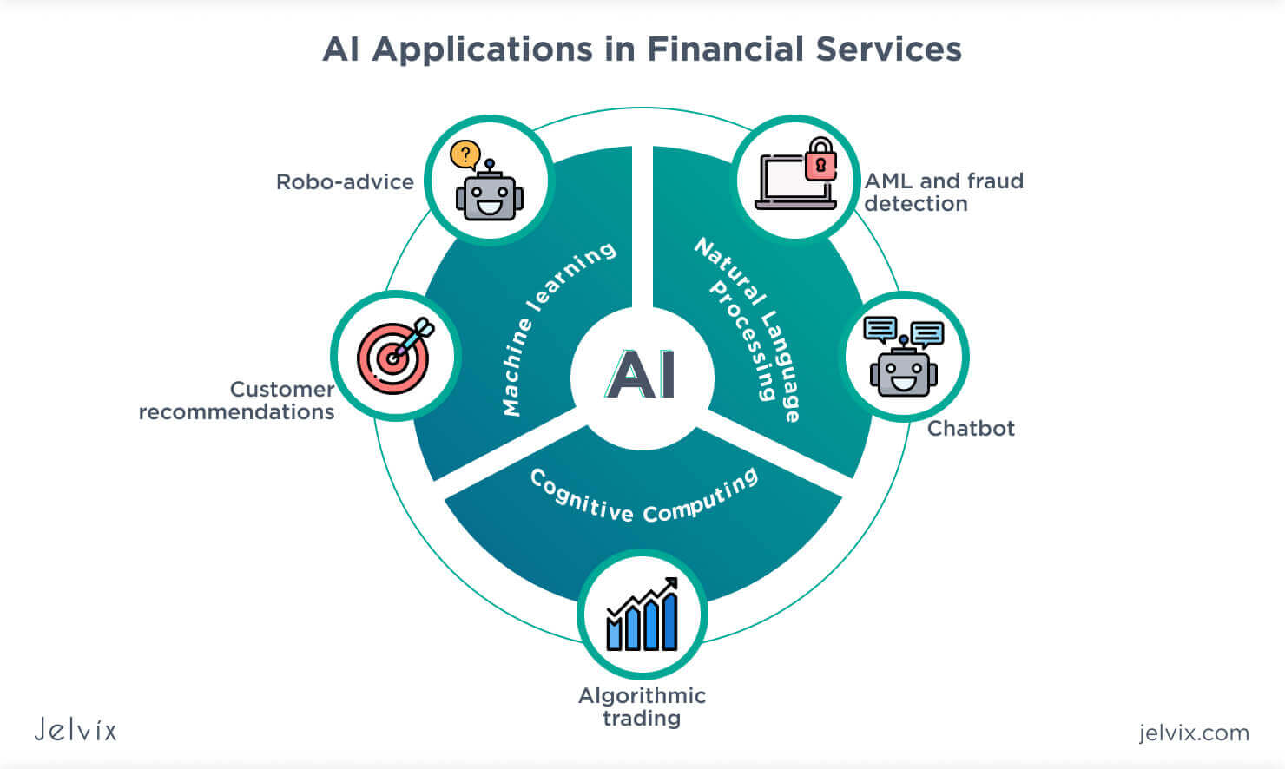
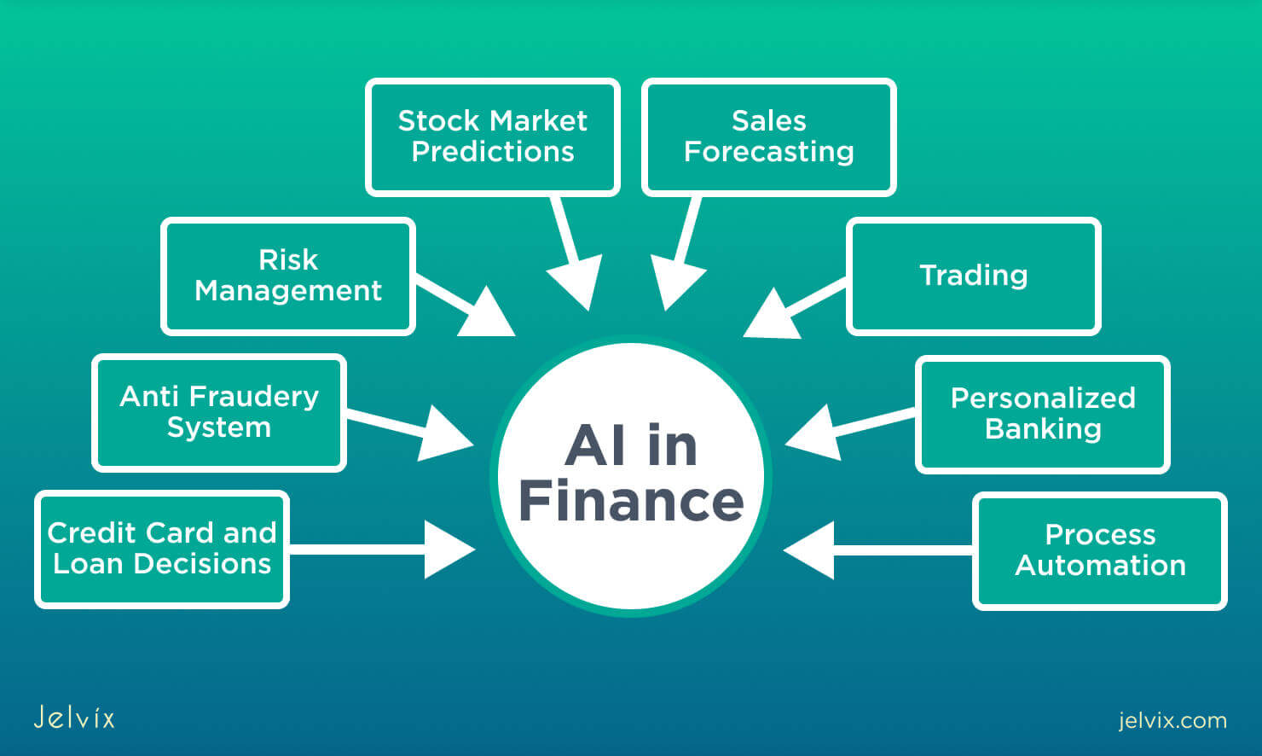
AI in Finance
Notes:
https://builtin.com/artificial-intelligence/ai-finance-banking-applications-companies
https://www.insiderintelligence.com/insights/ai-in-finance/
https://www.oracle.com/erp/ai-financials/what-is-ai-in-finance/
https://accern.com/commercial-banks/
25 Examples of AI In Finance 2022 | Built In
15 Examples of AI In Banking | Built In
Image Source: https://jelvix.com/blog/ai-in-finance
======
https://www.slideteam.net/tag/business-acumen-powerpoint-templates-ppt-slides-images-graphics-and-themes

Slide 15
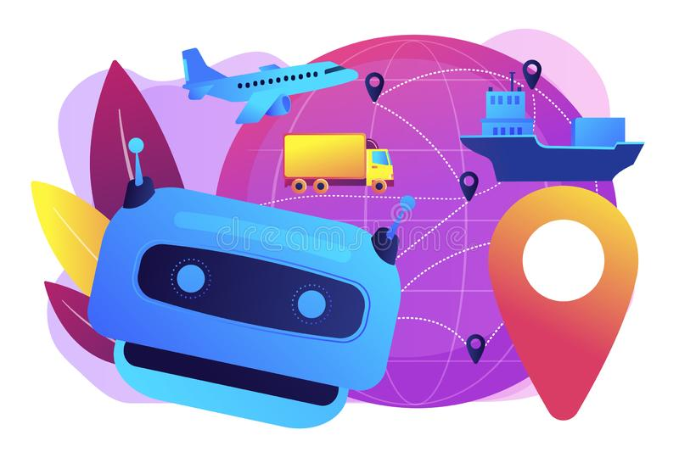
AI in Travel & Transport
Self-driving Vehicles
Air Taxi
Traffic Management
Shipping, navigation, and ports
Drone Control
Intelligent train automation
Life-saving Cars
Aviation
Autonomous Trucks
Public Transportation
Notes:
https://www.europarl.europa.eu/RegData/etudes/BRIE/2019/635609/EPRS_BRI(2019)635609_EN.pdf
https://amconsoft.com/how-ai-is-transforming-the-transportation-industry/
https://www.superb-ai.com/solution/transportation
Image source: https://www.dreamstime.com/ai-travel-transportation-concept-vector-illustration-artificial-intelligence-delivery-logistics-distribution-image150130746

Slide 16
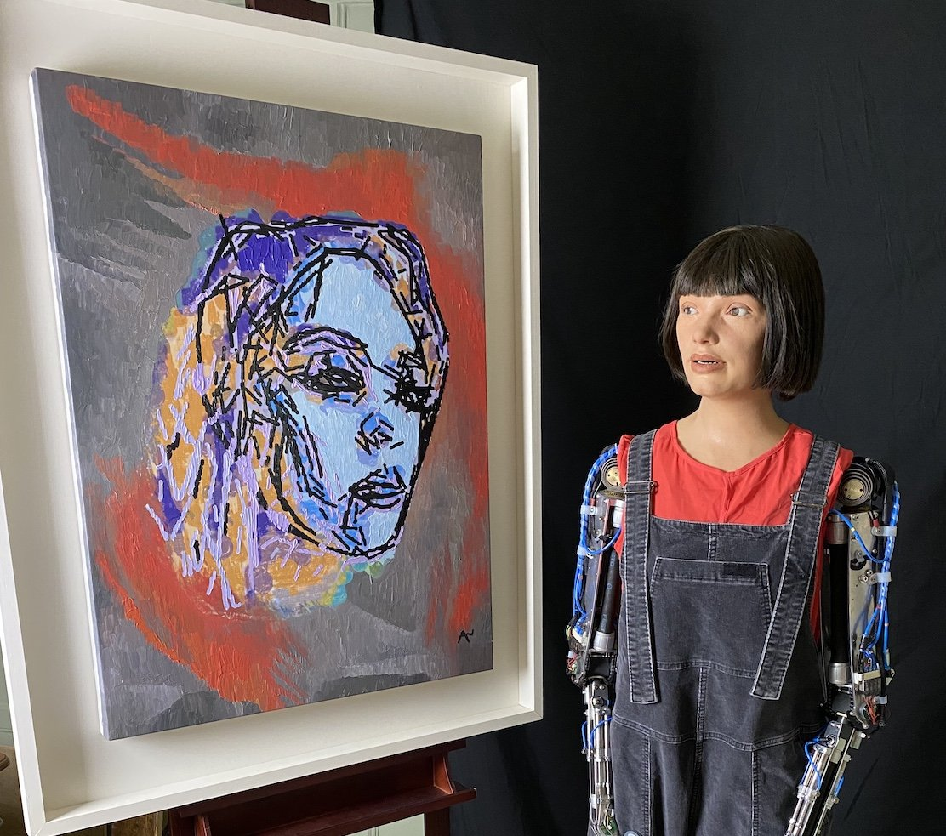
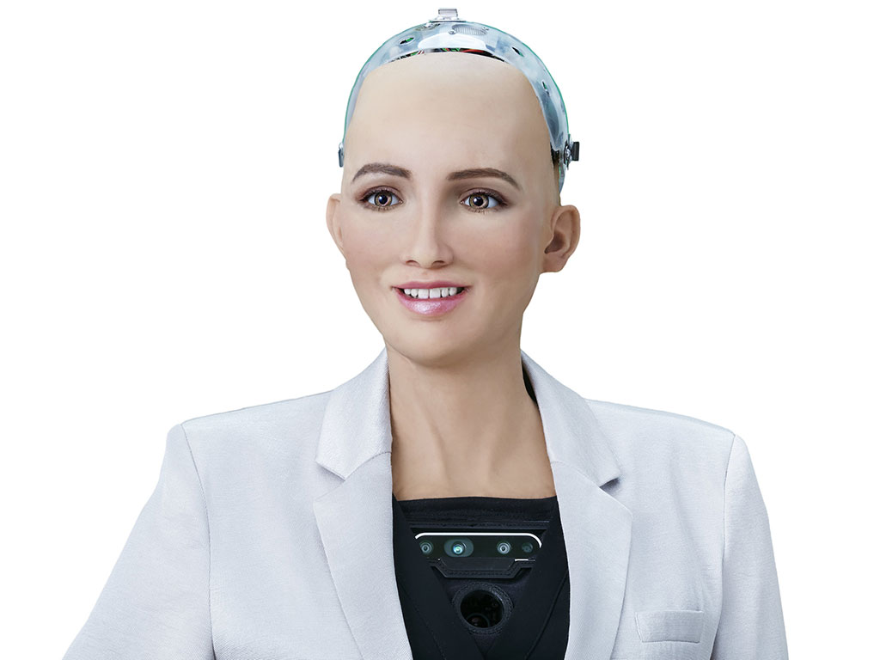
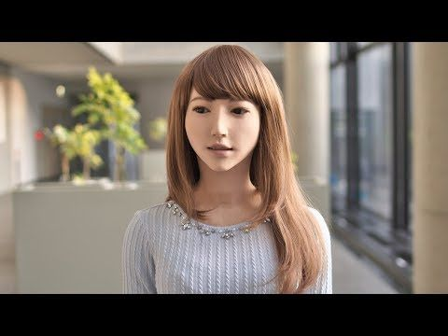
AI in Robotics
AI-Da
Sophia
Erica
Robotics AI companies
Notes:
10 Most Advanced AI Robots in the World
https://www.youtube.com/watch?v=zhVDk8Y55pA&list=WL&index=1
Top 20 Humanoid Robots in Use Right Now | Built In
https://builtin.com/robotics/humanoid-robots

Slide 17
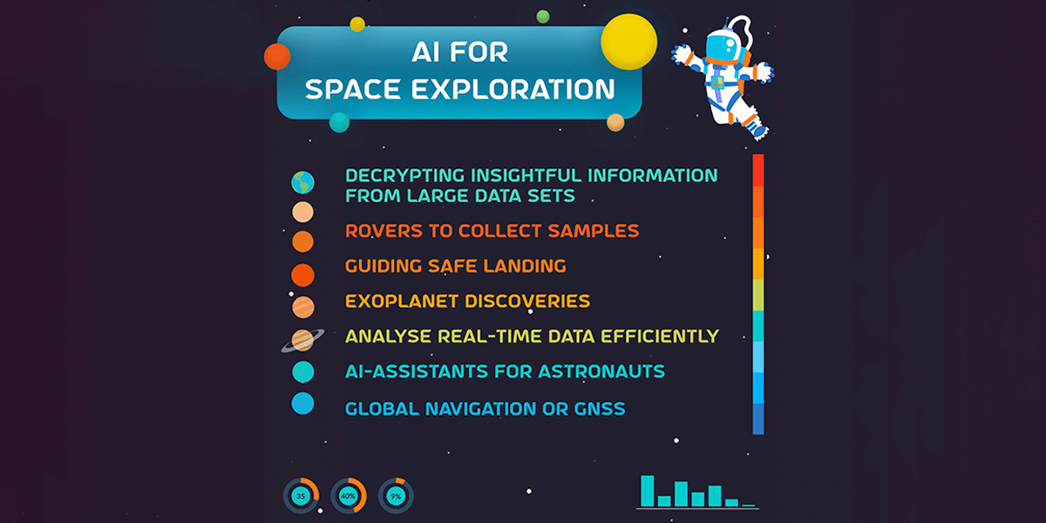
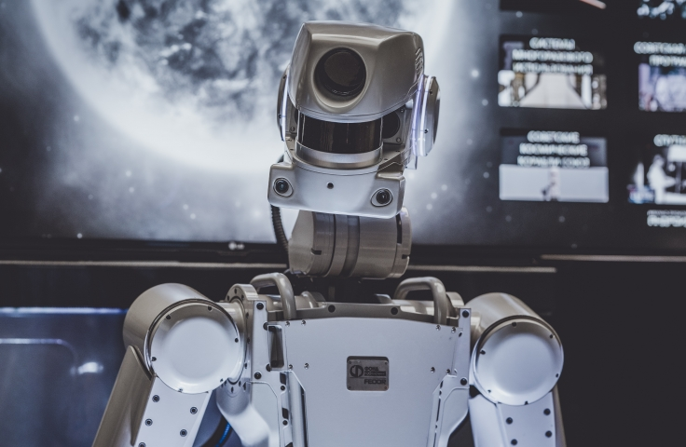
AI in Space Exploration
Autonomous rovers
Assistants and robots
Intelligence navigation system
Satellite data processing
Mission design and operations
Mission strategy
Space debris location
Data collection
Exoplanet discovery
Notes:
https://www.aiacceleratorinstitute.com/ai-in-space-exploration/
https://www.esa.int/Enabling_Support/Preparing_for_the_Future/Discovery_and_Preparation/Artificial_intelligence_in_space
https://mindy-support.com/news-post/the-role-of-ai-in-space-exploration/
https://www.analyticssteps.com/blogs/ai-space-exploration-all-you-need-know
https://futurism.com/nasa-ai-will-lead-the-future-of-space-exploration
Image source: https://www.unsw.adfa.edu.au/our-research/priorities/space/research
https://aiworldschool.com/research/could-artificial-intelligence-boost-space-exploration/

Slide 18
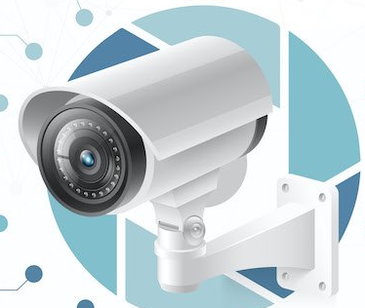
AI in Surveillance
Video Content Analytics
Video Forensics
Traffic and Road Safety
Object Detection
Object Segmentation
Object Tracking
Object Recognition
Object Classification
Vehicle model detection
3D face reconstruction
Video enhancement by Image Super-resolution
Video De-hazing and noise reduction
License Plate De-hazing
Predictive Image searching
No-Helmet and Triple riding detection
Wrong-way Driving or Illegal turn detection
No-Parking violation detection
License Plate Detection
Stop-Line Crossing Detection
No-Seatbelt or Mobile Usage detection
Over-Speeding Detection
Notes:
https://www.forbes.com/sites/forbestechcouncil/2020/12/04/how-ai-is-making-an-impact-on-the-surveillance-world/?sh=56a1bae265ef
https://www.mistralsolutions.com/blog/security-surveillance-role-artificial-intelligence/
Image source: https://emerj.com/ai-sector-overviews/ai-for-physical-security/

